Slide 1
Review of Linear Regression
Two ways to derive the “master formula”
Extending the reach of linear regression – nonlinearities through basis functions
Preventing overfitting by adding regularization terms
Bayesian perspective on weight norm penalty

Slide 12
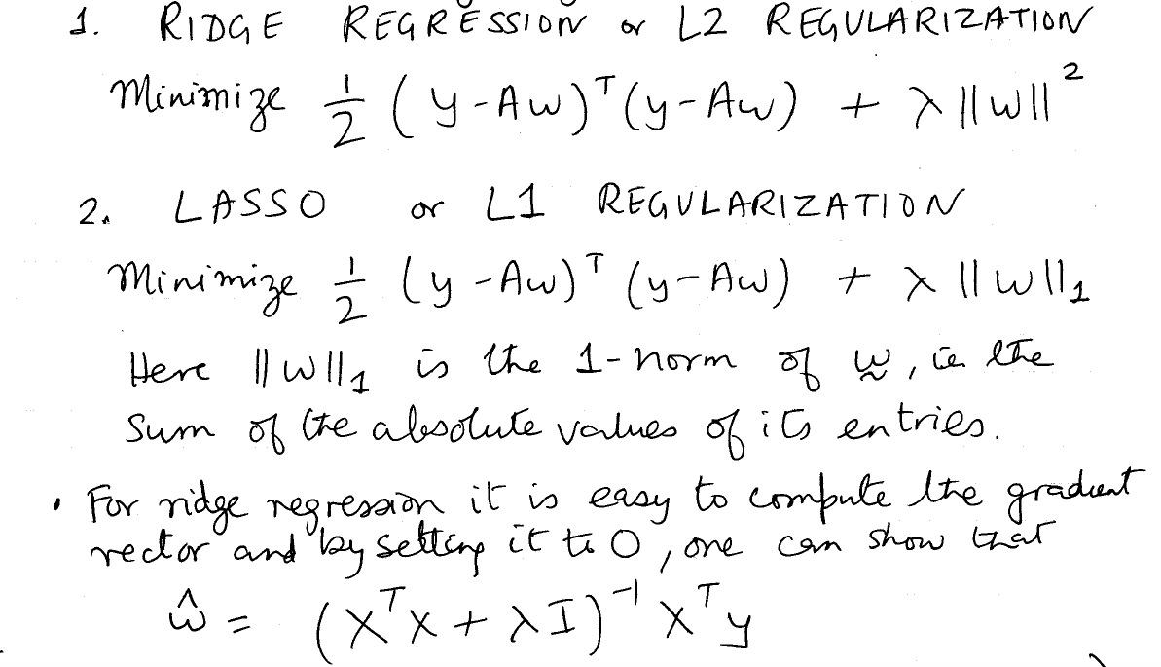
Variants to reduce over-fitting

Slide 17
Variants to reduce over-fitting

Slide 18
Logistic Regression
Logistic Regression is a classification method (the output is binary, not a real number)
We model the posterior probability by a logistic function whose argument is a linear function of the features + a bias term
We can justify this choice in multiple ways
Logistic regression can be extended to K classes, and is a building block for understanding neural networks.

Slide 19
Three ways of building classifiers
Generative
Discriminative
Find decision boundaries

Slide 20
Posterior probability for Gaussian class-conditional densities
(important)We assume that the variances are the same for the different classes
We do the calculation for 1D feature vectors initially; later we will see that the d-dimensional case works out quite similarly
We will find that the posterior probability is a logistic function of

Slide 21
Proof that the posterior is a logistic(1)

Slide 22
Proof that the posterior is a logistic(2)

Slide 23
Proof that the posterior is a logistic(3)

Slide 24
Graph of the logistic function

Slide 25
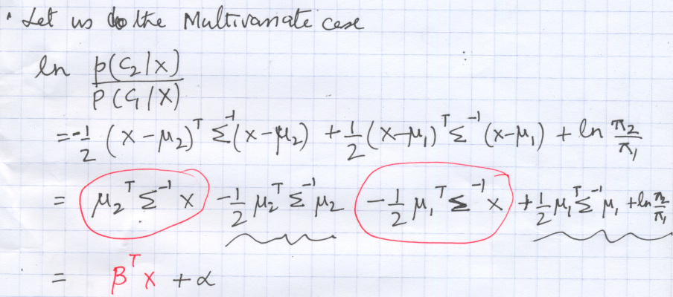
The posterior is logistic for multivariate Gaussians (1)

Slide 26
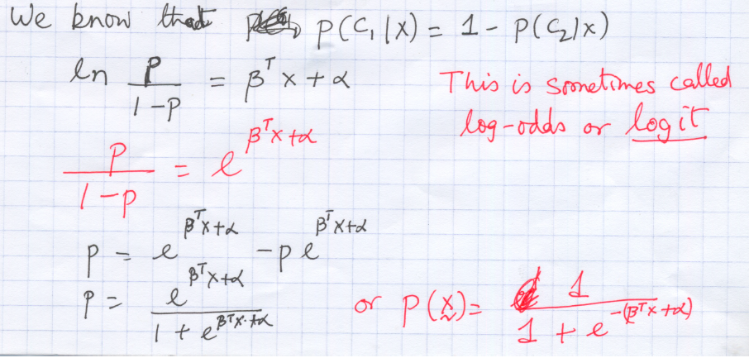
The posterior is logistic for multivariate Gaussians (2)

Slide 27
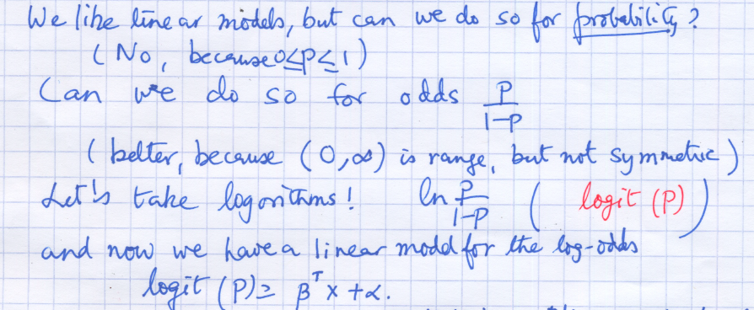
A heuristic argument for the logistic

Slide 28
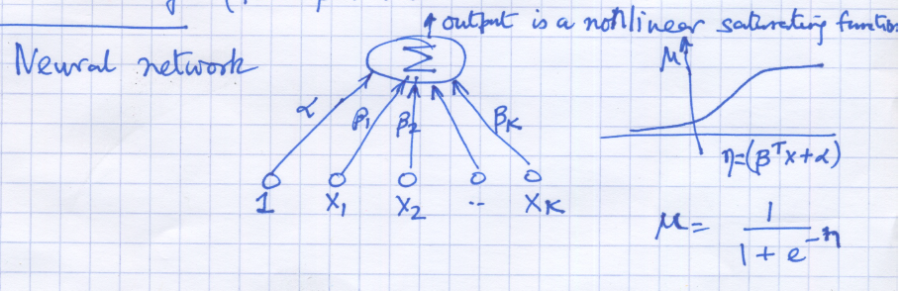
Neural networks can be modeled by logistics

Slide 29
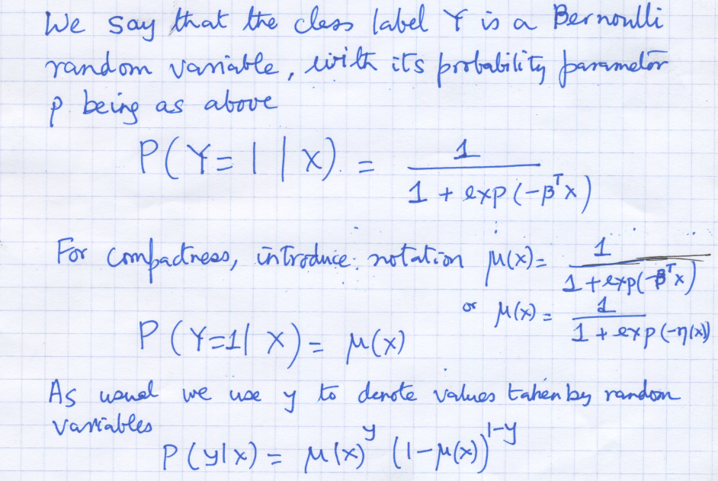
Modeling the probability distribution

Slide 30
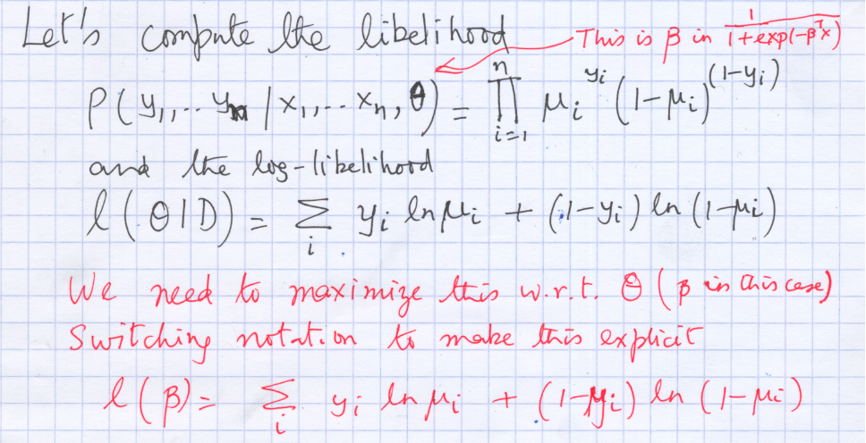
Maximum Likelihood Estimation

Slide 31
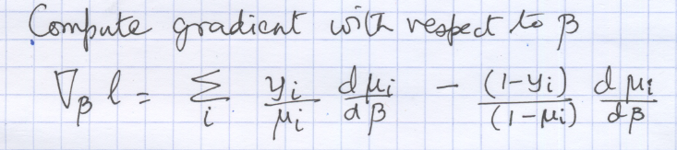
Next, we compute the gradient of the log-likelihood

Slide 32
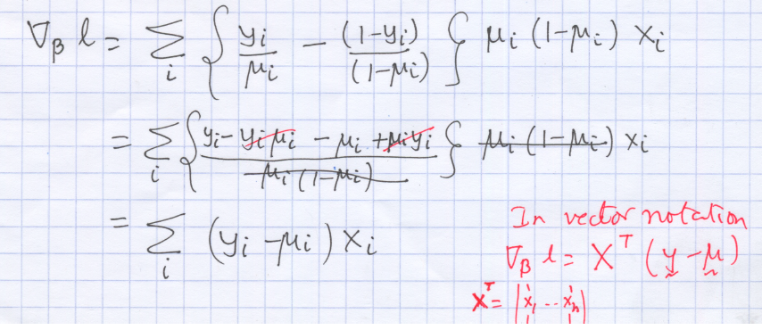

Slide 33
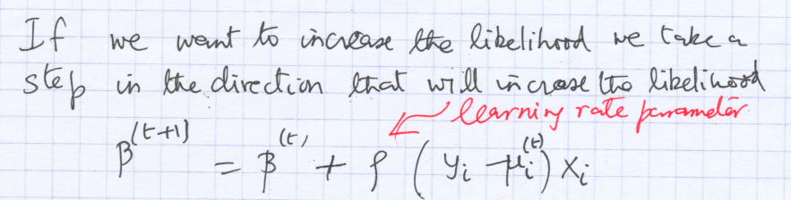
Stochastic Gradient Descent

